Slide 1
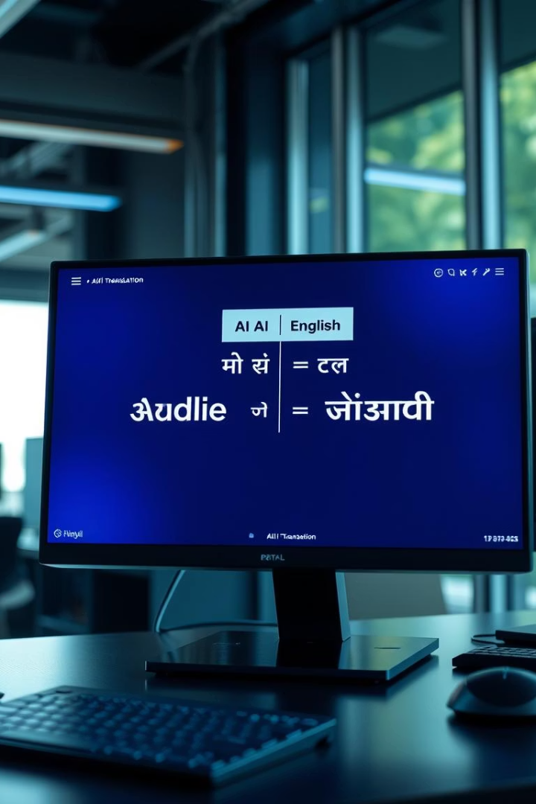
AI-Based English to Hindi Translator using NLP
This presentation covers an AI-powered English-to-Hindi translation web app using advanced NLP.

Slide 2

Introduction
Project Focus
AI-based application translating English text to Hindi and converting text to speech.
Primary Goal
Make translation and language access seamless, simple, and real-time.

Slide 3
Technology Stack
Python for core application logic
Streamlit for responsive web UI
Hugging Face MarianMT for neural machine translation
gTTS for converting Hindi text to speech
Torch for deep learning model processing
Deployment via GitHub and Streamlit Cloud

Slide 4
System Workflow
User Input
1
User inputs English text in the web app interface.
2
Translation
Text is sent to MarianMT for accurate Hindi translation.
Display Output
3
Translated Hindi text appears on the screen instantly.
4
Audio Conversion
gTTS converts text to Hindi speech audio.
Playback
5
Audio plays in the browser using Streamlit’s audio player.

Slide 5

THANK YOU
TEAM MEMBERS -
PARTH PATEL
MAHI SHAH
MANUSH PATEL

